Slide 1


SOCIAL
BUZZ

Slide 2


Today's agenda
Project recap
Problem
The Analytics team
Process
Insights
Summary

Slide 3

Social Buzz is a fast-growing technology unicorn that need to adapt quickly to its global scale.
Accenture has begun a 3-month POC Focing on these tasks:
-> An audit of School Buzz’s big data practise.
->Analysis to find Social Buzz’s top 5 most popular categories of content
Project Recap

Slide 4

Problem
Over 1000000 posts per day
36,500,000 piecers of content per year!
But how to capitalize on it when there is so much?
Analyse to find Social Buzz’s top 5 most popular categories on content

Slide 5



DEF CHIEF TECHINICAL ARCHITECT
The Analytics team
XYZ SENIOR PRINCIPLE
ABC CHIEF TECHNICAL ARCHITECT

Slide 6
Process
1
DATA UNDERSTANDING
2
DATA CLEANING
3
DATA MODELING
4
DATA ANALYSIS
5
UNCOVER INSIGHTS

Slide 7

Insights
16
UNIQUE CATEOGARIES
ANIMAL
MOST FAVOURITE CATEOGARY
MAY
WITH MOST NUMBER OF POSTS

Slide 8
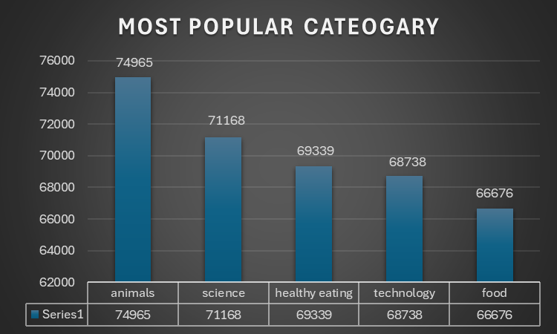

Slide 9
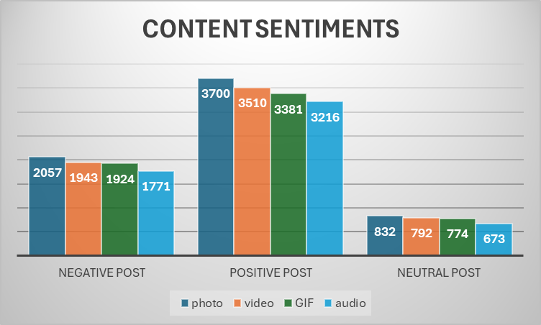

Slide 10
Thank you!
ANY QUESTIONS?

